Slide 1
E-Cigarettes: Different, But Not Safe
test
Presented by the UC Davis NIEHS T32 training program:
Advanced Training in Environmental Health Sciences
Notes:
Warning: this presentation contains some graphic images…

Slide 2
How Scientists Get Their Data
1. Models
2. Observing lots of humans
Several hundred people getting sick > a few healthy guys you know
3. Learning from other people’s experiments
Were their controls good?
Did the things they test actually represent the disease?
Notes:
If something causes molecular changes in animals…
And those molecular changes cause some diseases in animals…
And those molecular changes are associated with that disease in humans…
Then we believe E-cigs probably cause those diseases in humans.
“Our goal is not to sell you anything. Our goal is to gather data and find the truth.
The truth is, there are lots of things we don’t know about e-cigs and some things we do know.
The things we know are enough to make us concerned.”

Slide 3
“In school, you’re taught a lesson and then given a test. In life, you’re given a test that teaches you a lesson.” ~Tom Bodett
T/F: With e-cigs you only inhale water.
T/F: Switching from regular cigs to e-cigs decreases health risks caused by tobacco.
T/F: In 2009, the FDA started verifying health labeling on e-cigs.
What reaction occurs in e-cigs? Boiling, combustion or precipitation?
What is the addictive ingredient? Glycerin, cinnamaldehyde, or nicotine?
What is the term for e-cig smoke that settles on carpet & walls? Secondhand, thirdhand, or pollutionary?
What percent of adults vape? Under 5, 5-10, 10-20, 20-30, or over 30?
.False. Lots of chemicals in E-cig smoke.
.True. E-cigs often replace tobacco health risks with other, different health risks.
. False. E-cig labeling is unverified, unreliable, and sometimes entirely false.
. E-cigs are boiled/”vaporized,” whereas tobacco cigs are combusted.
. Nicotine is addictive in both e-cigs and regular cigs.
. Thirdhand smoke poisons people who weren’t present when it was generated.
. 3.2%. Not everyone’s doing it.

Slide 4
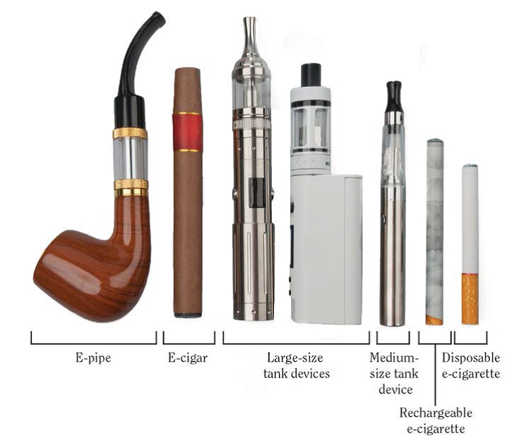
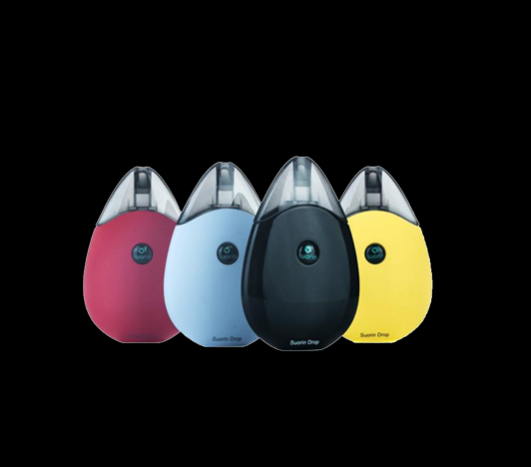
What is an E-cig?
Notes:
-battery-powered devices intended to deliver nicotine by heating a liquid solution to form an
aerosol, which is then inhaled in a fashion that mimics smoking.
-In contrast, conventional cigarettes contain tobacco leaves that undergo chemical combustion to produce smoke that delivers nicotine.
-goal of the ecig was to prevent burning tobacco.
-The devices have evolved from the first-generation designs produced which were similar to conventional cigarettes in appearance, to the currently marketed compact devices that are more discrete, as exemplified by recent models that look similar to thumb drives.

Slide 5
Myths about e-cigs…

Slide 6
Myth: E-cigs are safer than regular cigarettes “It’s just water vapor.”
Toxic chemicals
E-juice Flavorings Lung Irritants Propylene glycol
& glycerin
Heavy Metals
Coil and heating
Components Addictive chemicals
Unknown amounts of nicotine
Burns & explosions
Battery
E-cig aerosol contains at least 10 chemicals known to cause cancer, birth defects, or other reproductive harm.
Notes:
Question: How many people have heard this statement?
For e-cigs to produce water vapor, the vape-juice must be just water or
All the organic compounds would have to completely combust
Vape-juice is actually...
Propylene glycol is the chemical used to make theater fog, which can irritate the lungs with sufficient concentration and duration, such as among employees in venues with fog machines
When heated propylene glycol can produce formaldehyde, a known carcinogen
Glycerol when heated can produce acrolein
Acrolein is a known toxin that binds proteins and DNA--making it a mutagen
However, no long-term studies have been completed to show acrolein is a carcinogen
The heating coil also releases metals...

Slide 7
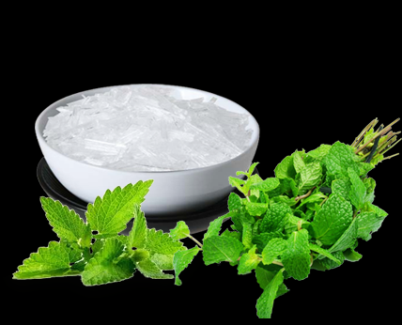
Ingredient: Flavorings
Notes:
Many users are attracted to vaping because they enjoy the flavors
Several flavorings have direct health effects:
Over time, inflammation associated with popcorn lung causes lung tissues and airways to scar and narrow, causing breathing difficulties.
Popcorn lung gets its name because a chemical called diacetyl, which was once commonly used to give food products, such as popcorn, a rich, buttery flavor, was found to cause the destructive, irreversible lung disease known as bronchiolitis obliterans. In fact, the condition was first identified among popcorn factory workers who inhaled the chemical in the workplace. Popcorn lung is a rare medical condition that damages the bronchioles, the lung's smallest airways.
Diacetyl has been used in e-liquids with buttery, smooth and savory flavors. Diacetyl can also be formed during the vaporization process from e-liquids that do not contain diacetyl. Replacement flavorings such as 2, 3-pentanedione have also been shown to have adverse effects in studies.
Cinnamaldehyde, the flavoring used in cinnamon flavored, spicy and tobacco e-liquids, is toxic to all cultured lung epithelial cells tested so far. Although there is not yet sufficient evidence to identify flavorings as carcinogens, many modify proteins and DNA in experimental models.
Menthol is found in minty and cool flavors and helps ease the harshness of nicotine containing vapors. Menthol augments the effect of nicotine (transition to next slide)

Slide 8
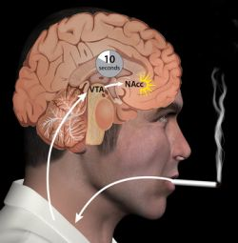
Ingredient: Nicotine
Nicotine is addictive. And the
flavorings in e-cigarettes only
enhance this effect...
Notes:
Nicotine is one of the major ingredient in e-cigarette. It binds nicotinic receptors in the brain to promotes neurotransmitter dopamine and GABA release.
These two type of neurotransmitters are known as rewards transmitter. Nicotine stimulates the reward system in the brain. Reward system is the neural network that are used to reinforce the behaviors that are recognized as pleasure or achievement. Long term use of nicotine product produces an addictive effect, which makes it hard to quit smoking.
Other ingredients in the e-cigarette such as flavoring agents--especially menthol--can enhance this additive effect of nicotine and produce the negative effect when a person withdraw from nicotine.
Juul pods all contain nicotine; there is no nicotine free juul pod
The majority of Suorin dripfire juices contain nicotine and menthol

Slide 9
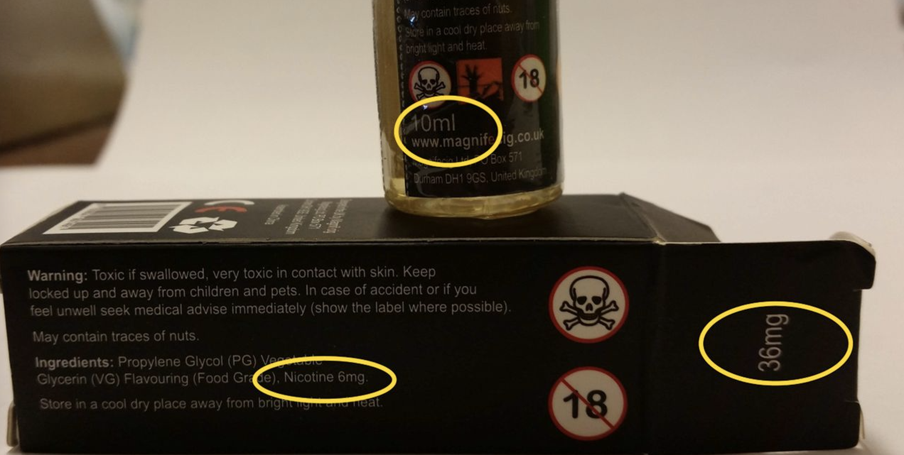
Myth: There are nicotine-free e-liquids
Labeling on e-liquid containers is not regulated, so even if you buy “nicotine-free” you might be getting e-juice with nicotine in it.
Even if you purposely purchase an e-cig with nicotine, the amount in e-liquid is unregulated and often mislabeled.
Notes:
Make a greater point about nicotine bundle with addiction of nicotine
Studies have shown that nicotine levels reported on e-liquids do not represent the amount of nicotine actually present in the e-liquid making it difficult to eliminate or limit nicotine
Nicotine is “sticky” so any device that’s ever had nicotine can never deliver no nicotine ever again

Slide 10
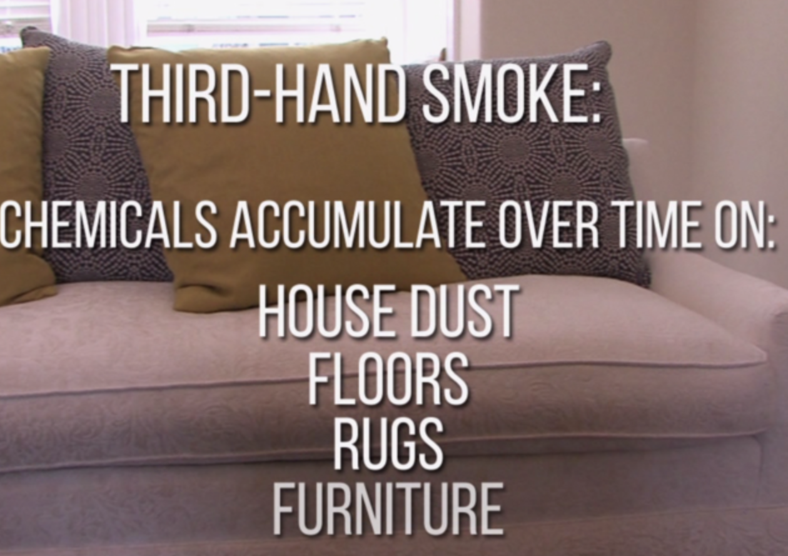
Myth: E-cigs are not dangerous to younger siblings
Notes:
Thirdhand exposure is exposure to chemicals found in EC vapor and liquid by coming in contact with surfaces these chemicals stick to.
Different EC products will cause different types of thirdhand exposures to a variety of chemicals.
Thirdhand nicotine and other EC products can be detected days and even months later.

Slide 11
Myth: E-cig companies are not targeting youth
Food E-liquid
Notes:
Can you tell if a product is e-liquid or food?

Slide 12
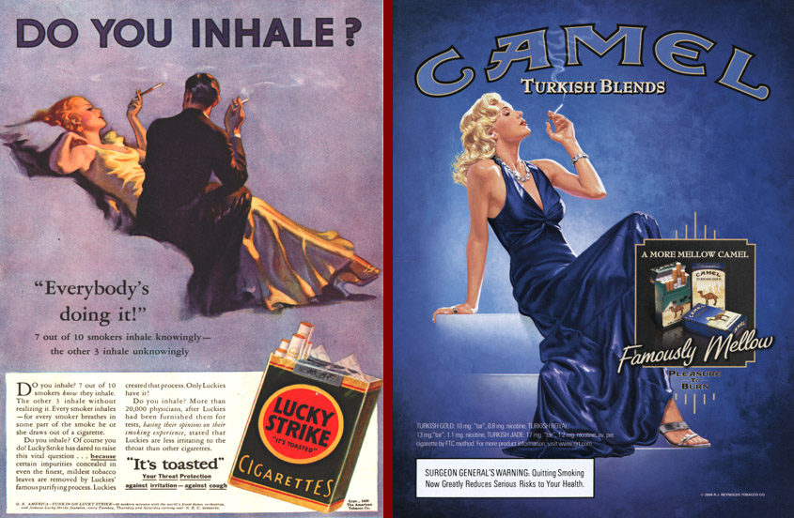
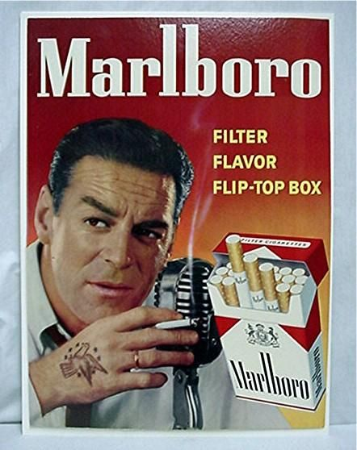
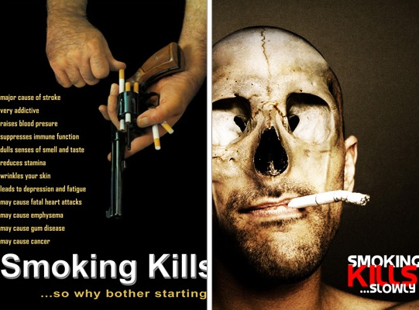
Myth: E-cigs make me look cool
This did too.
Now it looks like this.

Slide 13
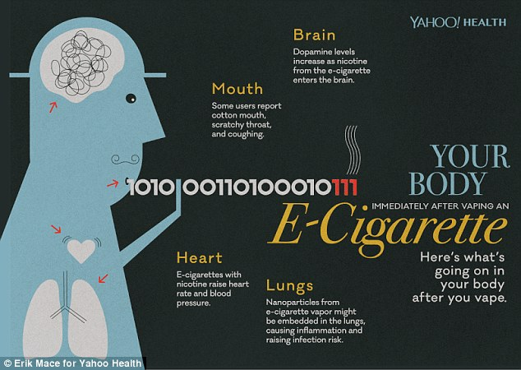
What are the health risks?

Slide 14
Health Risk: Lung Disease
Worsens asthma
Increases frequency of attacks
Increases wheezing
Decreases lung function as a whole
Causes Bronchitis
Increased coughing
Increased mucus
Fatigue & shortness of breath

Slide 15
Health Risk: Oral Disease
While they don’t turn your teeth yellow, they could lead to…
Gum Recession
Loss of Teeth
Inflammation

Slide 16
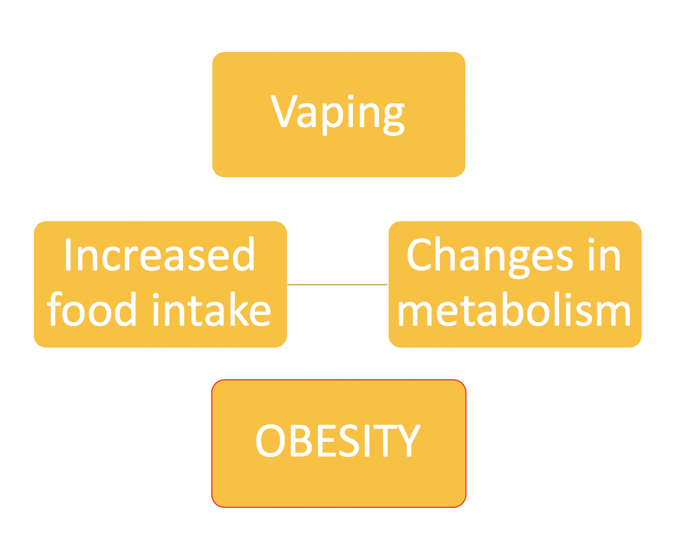
Health Risk: Obesity
Notes:
This slide can be even more simplified and larger. Vaping> increased food intake> obesity> increased chances of diabetes and other diseases.

Slide 17
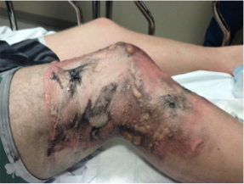
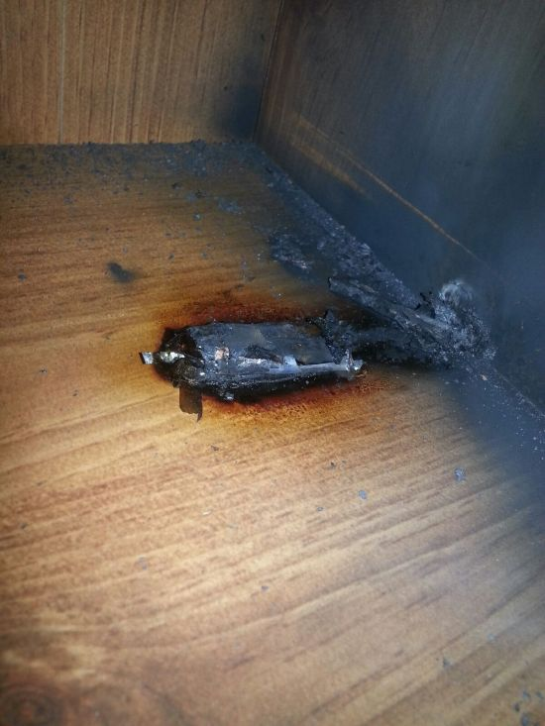
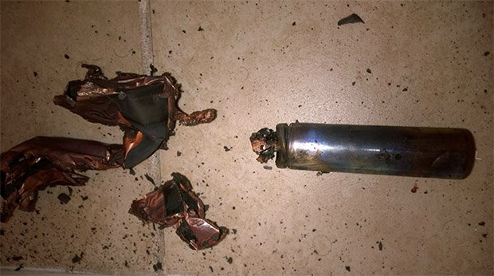
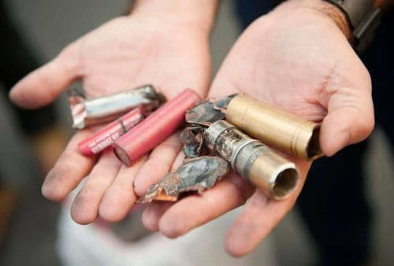
Health Risks: Physical Hazards & Explosions
The lithium batteries in e-cigs can ignite during use, charging, or transport
Notes:
What is the frequency of battery explosions?
https://www.usfa.fema.gov/downloads/pdf/publications/electronic_cigarettes.pdf

Slide 18
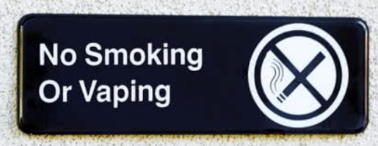
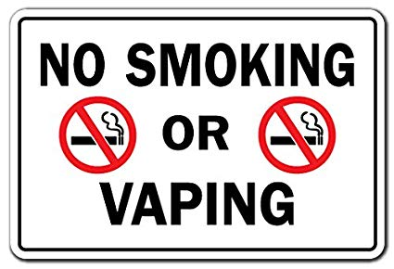
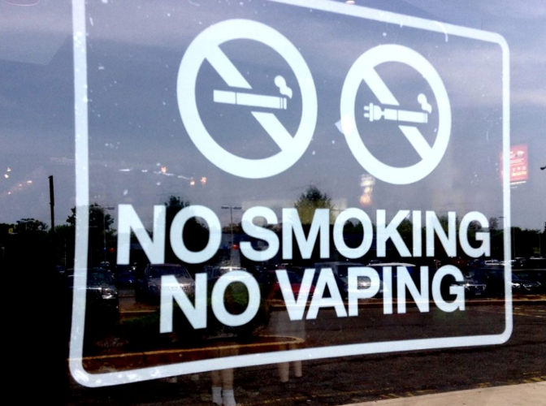
In conclusion…
Numerous health risks are emerging.
You have been warned.

Slide 19
Questions?

